Slide 1

Capstone Project
Determing the optimal location for a venue
By: Daniel Ahmad

Slide 2
Table of content
Introduction
Problem formulation
Data preparation
Modelling
Conclusion

Slide 3
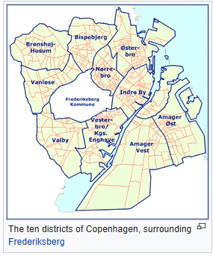
Introduction
Copenhagen city has roughly 1.2mill people.
10 districts
Capital city of Denmark
Denmark’s largest city

Slide 4
Problem formulation
Investigate the optimal location and venue type to open in Copenhagen.
This requires district names found on https://en.wikipedia.org/wiki/Districts_of_Copenhagen
Geographic coordinates found using geocoder library
Venue data using foursquare api

Slide 5
Techniques used
Web scraping for retrieving data from url
Dataframes for storing the data
Kmeans clustering for machine learning algorithm
Reason: Unsupervised learning

Slide 6
Data preparation
Web-scraping
Removal of NaN
Constructing of dataframes
Applying get_dummies to convert categorical to numerical features.

Slide 7
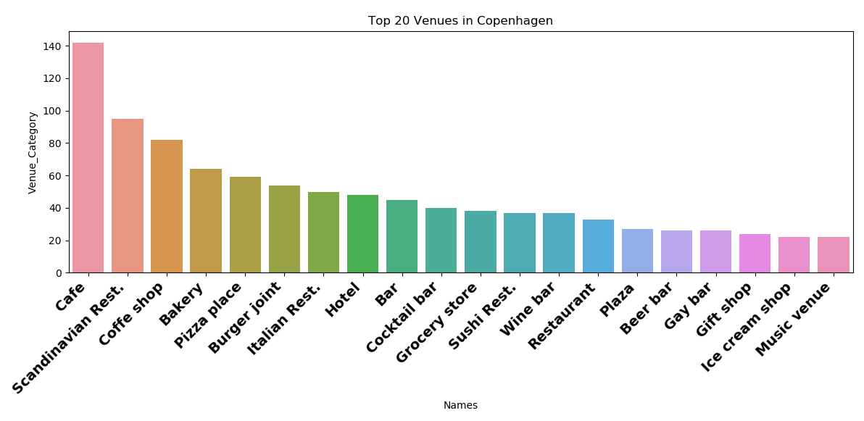
Modelling: EDA
Exploring the data to understand what is present
Café the most popular with 142 total venues.
Majority are related to eating places.

Slide 8
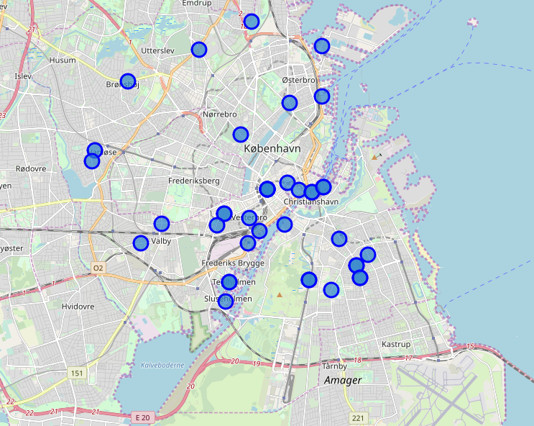
Modelling: Plotting districts
Copenhagen districts/neighborhoods plotted to visualized
Majority close to the center indicated with green circle

Slide 9
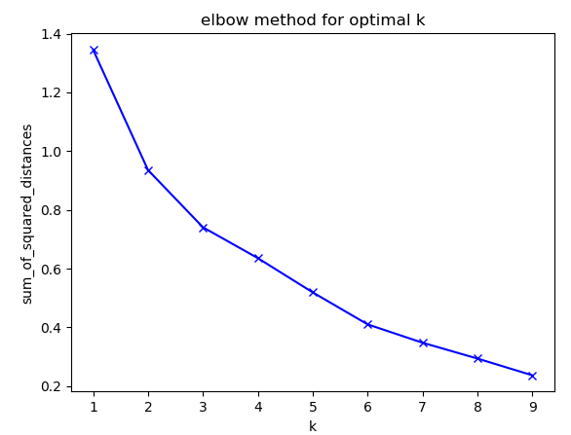
Modelling: Determining optimal K value
Optimal K found using elbow method.
Sum of squared distances used to quantify.
Optimal K found to be 3

Slide 10
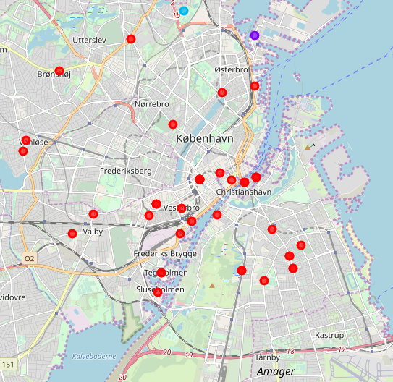
Modelling: Visualizing clusters
Cluster 0(red) with highest number of locations.
Cluster 0 optimal place to open.

Slide 11
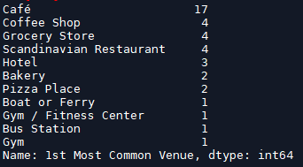
Modelling: Cluster 0
Café is the most popular
Good indication that most safe business plan would be to open a café.

Slide 12
Conclusion
Objective was to determine the optimal location and venue for an investor.
Optimal number of clusters was found to be 3.
Cluster 0 was the best place to open up a venue
Café is the safe business proposition since Danish people favor this venue type.
Could be interesting open a new eating place that is not common.
More thorough investigation is required for location prices, population within several km and available locations on the market.

